Slide 1


Building the Big Data Ecosystem with Cloudera Quickstarts VM
BIA-678 BIG DATA SEMINAR
Yang Yang
Lulu Zhu
Aug, 2017
Updated Jan, 2019

Slide 2
Outline
(Optional)
Test a MapReduce Job
Test an Rhadoop Job
Install Virtual Box
Open the Cloudera Quickstarts VM
Install Rhdaoop
Finish
Pyspark on Jupyter Notebook
Test a Spark Job

Slide 3
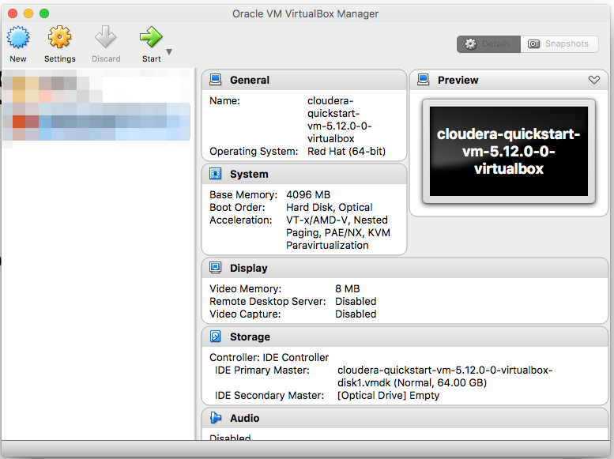
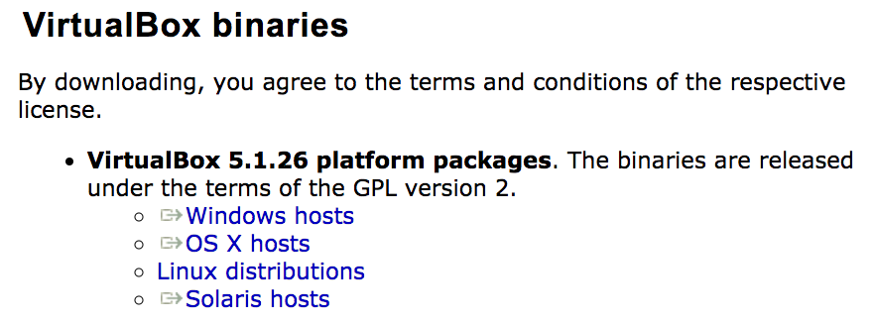
I. Install Virtual Box
1. Download Virtual Box via:
https://www.virtualbox.org/wiki/Downloads
2. Install it with default settings.
3. Open it and make sure you will see something like:

Slide 4

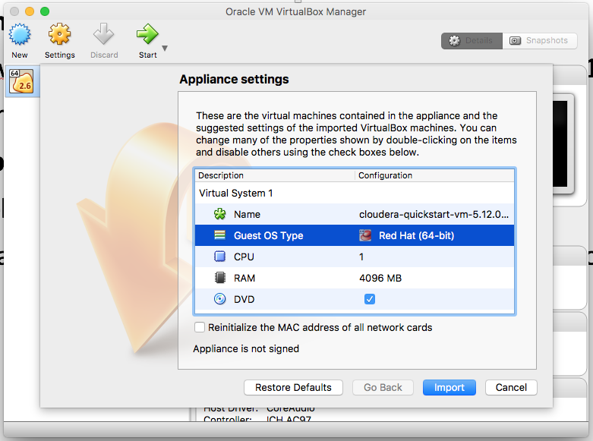
II. Open Cloudera QuickStarts VM
1. Download the Cloudera-quickstart-vm file via:
https://www.cloudera.com/downloads/quickstart_vms/5-13.html
(Platform: Virtual Box)
2. Unzip the file.
3. Double-click on.
cloudera-quickstart-vm-5.13.0-0-virtualbox.ovf
4. You will be asked to allocate your resources but the default is fine.
5. Click import. (may take long)
6. You’re all set!
Use the “File -> Import Appliance” menu inside VirtualBox to open your downloaded *.ovf file, or simply double-click on the file itself and VirtualBox should handle it from there.

Slide 5
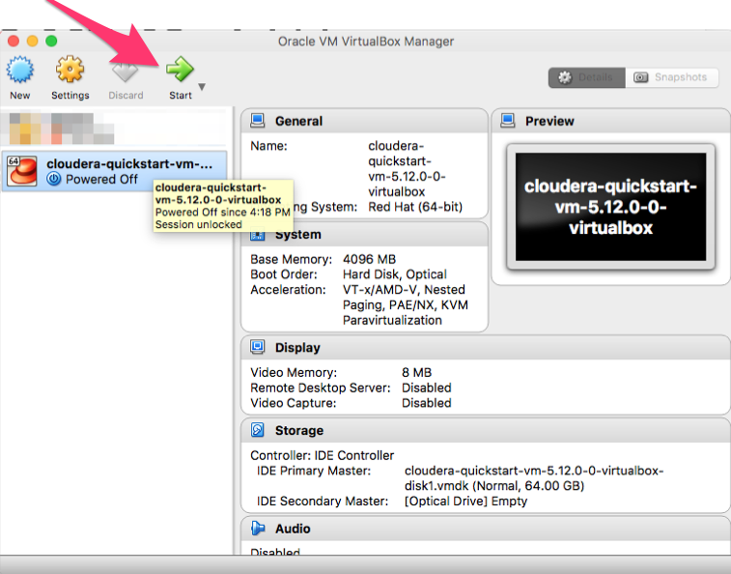
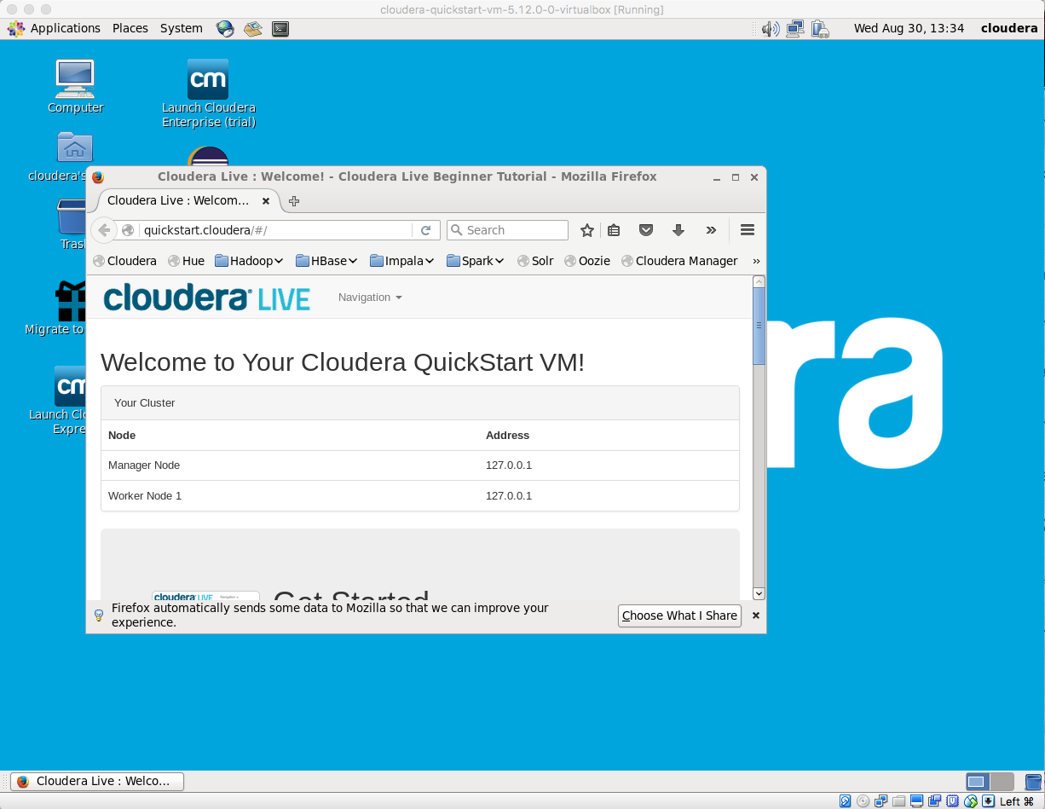
II. Open Cloudera QuickStarts VM
1. Start your Cloudera QuickStarts VM by clicking start( will take long) if you are using ubuntu 16.04, you may need to click "Settings" > System Settings > Processor, and disable the PAE/NX option.
2. Now we have a running virtual machine where Hadoop and Spark already installed!
3. If you don’t have a shared clipboard (you can’t copy at your host machine and paste at your VM), see the link below: https://apple.stackexchange.com/questions/132233/copy-and-pasting-between-host-and-vm

Slide 6
III. Test a MapReduce Job
Try a simple word count example by MapReduce
1. Open the Terminal
2. Make a directory for testing:
mkdir testing
3. Create some data:
echo "I love BIA678 very very much" > /home/cloudera/testing/test1
4. Create a directory in the HDFS file system and check the directories
hdfs dfs -mkdir /testing
hdfs dfs -ls /

Slide 7
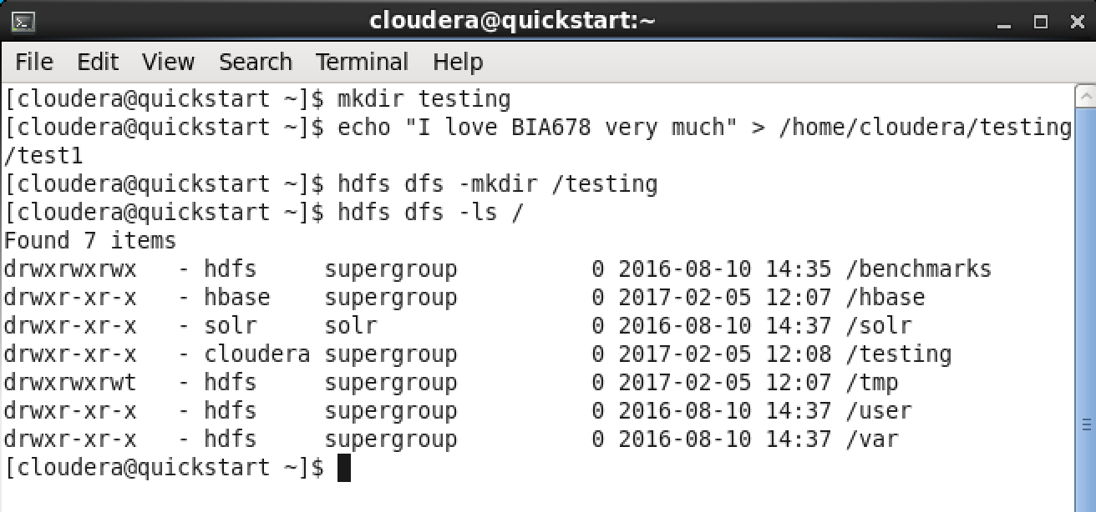
III. Test a MapReduce Job
It should be like this:
5. Put the file from local to HDFS:
hdfs dfs -put /home/cloudera/testing/test1 /user/cloudera/testing

Slide 8
III. Test a MapReduce Job
6. Create the test_mapper.py
gedit /home/cloudera/testing/test_mapper.py
Copy the following code, save & quit.
***Just copy and paste the entire codes. "\" is the symbol "backslash"
#!/usr/bin/env python
import sys
for line in sys.stdin:
line = line.strip()
keys = line.split(" ")
for key in keys:
value = 1
print('{0}\t{1}'.format(key, value) )

Slide 9
III. Test a MapReduce Job
Create test_reducer.py
gedit /home/cloudera/testing/test_reducer.py
Copy the following code, save & quit.
#!/usr/bin/env python
import sys
last_key = None
running_total = 0
for input_line in sys.stdin:
input_line = input_line.strip()
this_key, value = input_line.split("\t", 1)
value = int(value)
if last_key == this_key:
running_total += value
else:
if last_key:
print( "{0}\t{1}".format(last_key, running_total) )
running_total = value
last_key = this_key
if last_key == this_key:
print( "{0}\t{1}".format(last_key, running_total))

Slide 10
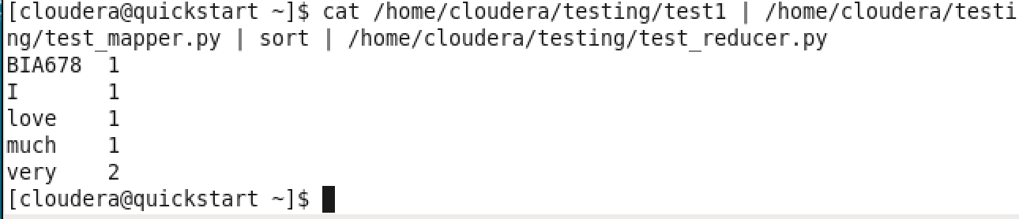
III. Test a MapReduce Job
7. Make the files excutable:
chmod +x /home/cloudera/testing/test*.py
8. Execute it without Hadoop by the piping commands to check if it's correct:
cat /home/cloudera/testing/test1 | /home/cloudera/testing/test_mapper.py | sort | /home/cloudera/testing/test_reducer.py
The result should be:

Slide 11
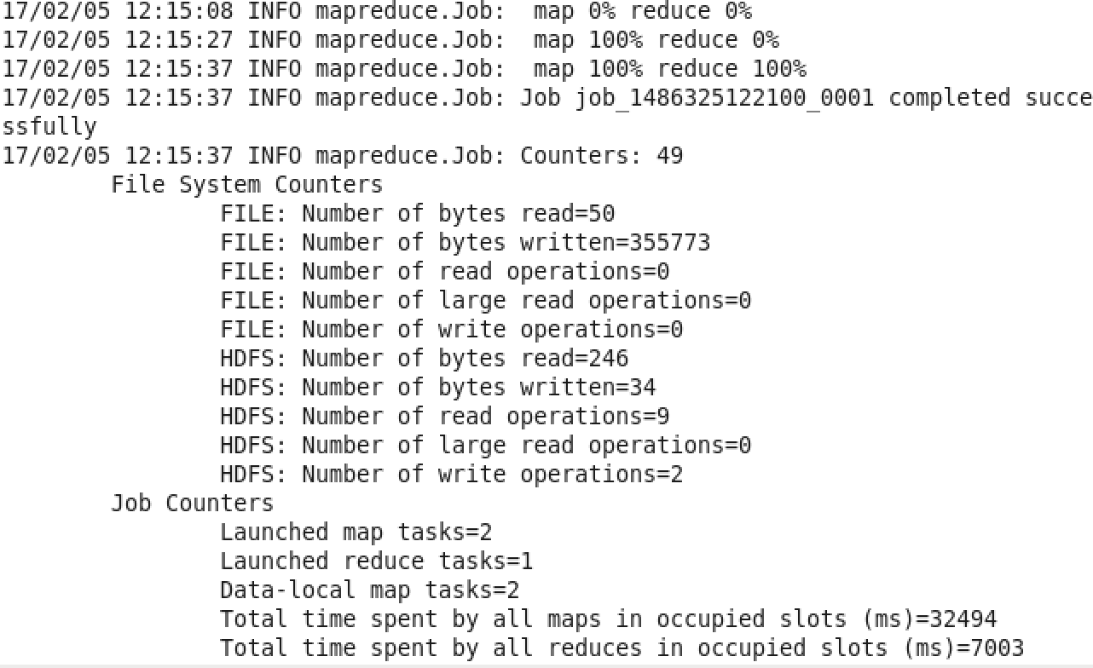
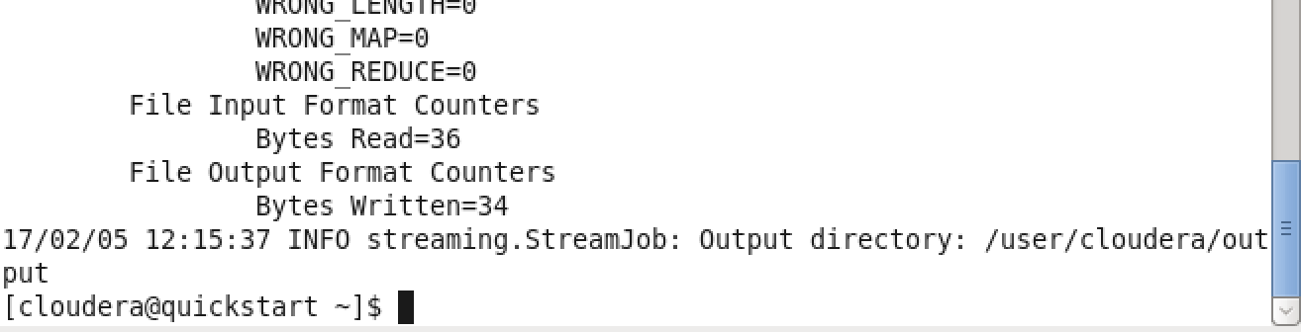
III. Test a MapReduce Job
9. Run the scripts by Hadoop:
hadoop jar /usr/lib/hadoop-mapreduce/hadoop-streaming.jar -input /user/cloudera/testing -output /user/cloudera/output -mapper /home/cloudera/testing/test_mapper.py -reducer /home/cloudera/testing/test_reducer.py
It takes a few seconds and the result should be:

Slide 12
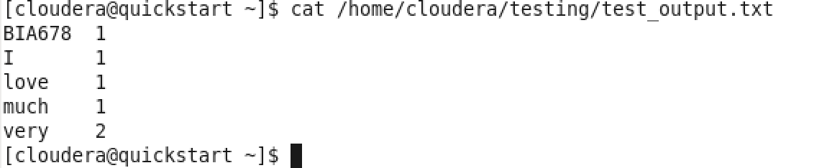
III. Test a MapReduce Job
10. Get the final result from HDFS to local and take a look at it:
hdfs dfs -get /user/cloudera/output/part-00000 /home/cloudera/testing/test_output.txt
cat /home/cloudera/testing/test_output.txt
The result should also be:

Slide 13
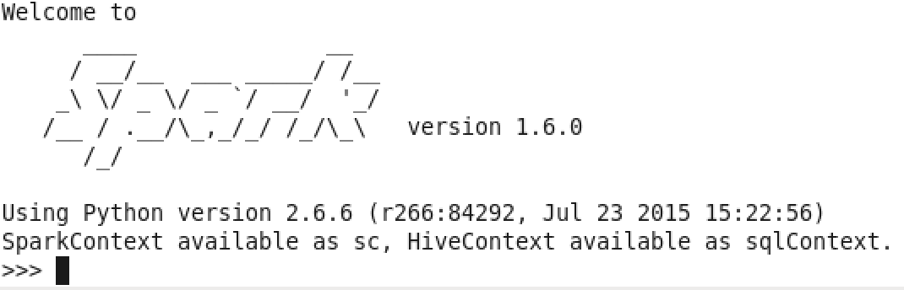

IV. Test a Spark Job^{[2]}
We are going to use pyspark to test whether Spark works.
1. Type in pyspark in the shell:

Slide 14
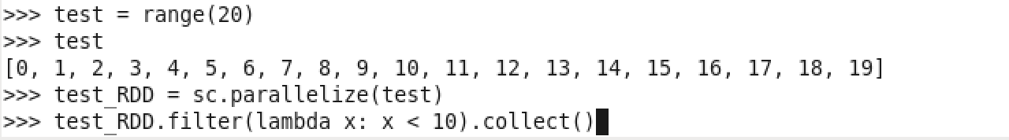
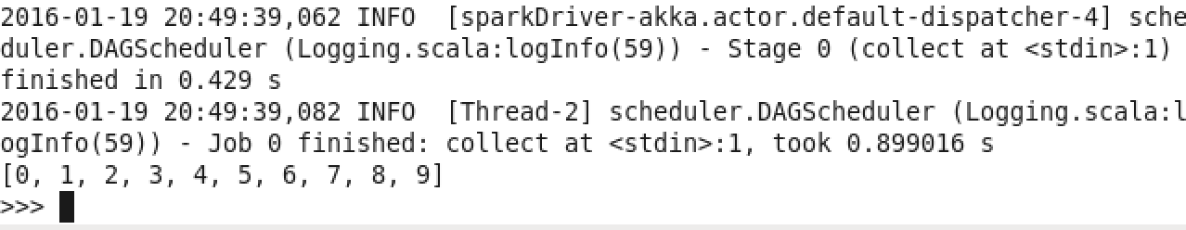
IV. Test a Spark Job
2. Type in the following code:
You will get:
3. Type quit() to exit pyspark.

Slide 15
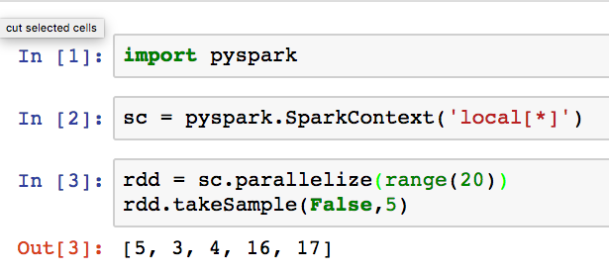
VII. Pyspark on Jupyter notebook
1. Running pyspark on Jupyter notebook would be much more convenient than on terminal.
2. An easy way to do this is to use docker instead of Cloudera Quickstarts VM.
3. Quit Virtual Box, open the terminal on your local machine.
4. Install docker following the docs: https://docs.docker.com/engine/installation/#supported-platforms
5. Check is docker installed: docker --version
6. Pull docker image from docker hub (you can think it as another Cloudera VM) and run it: docker pull jupyter/all-spark-notebook docker run -it --rm -p 8888:8888 jupyter/all-spark-notebook
7. Open the popped up link and run a simple example:

Slide 16
References
[1] Hao Han, Instructions for Loading VMware (Virtual Machine) and Hadoop, Stevens Institute of Technology, Oct 8, 2015
[2] Bhargavi Gutta, SPARK ON CLOUDERA, Stevens Institute of Technology, Fall 2015
[3-4] Dr. David Belanger, R-Hadoop Installation on Cloudera, Stevens Institute of Technology, Fall 2015
[5] Haotian Huang, Building the Cloudera Hadoop Ecosystem on Your Laptop, Stevens Institute of Technology, Feb 2017

